Slide 1


Slide 2
Technical Note 10
Facility Location

Slide 3

OBJECTIVES
Issues in Facility Location
Various Plant Location Methods
Notes:
2

Slide 4
Competitive Imperatives Impacting Location
The need to produce close to the customer due to time-based competition, trade agreements, and shipping costs
The need to locate near the appropriate labor pool to take advantage of low wage costs and/or high technical skills
Notes:
3

Slide 5
Issues in Facility Location
Proximity to Customers
Business Climate
Total Costs
Infrastructure
Quality of Labor
Suppliers
Other Facilities
Notes:
4

Slide 6
Issues in Facility Location
Free Trade Zones
Political Risk
Government Barriers
Trading Blocs
Environmental Regulation
Host Community
Competitive Advantage
Notes:
8

Slide 7
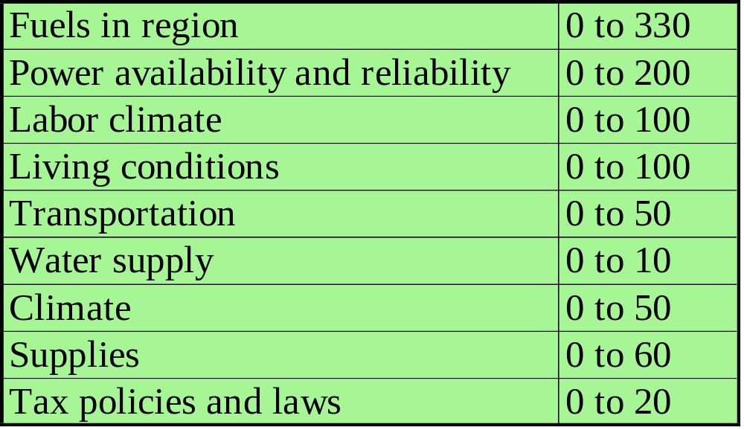
Plant Location Methodology: Factor Rating Method Example
Two refineries sites (A and B) are assigned the following range of point values and respective points, where the more points the better for the site location.
Sites
A B
Major factors for site location
Pt. Range
123
150
54
24
45
4
8
5
5
156
100
63
96
50
5
4
50
20
Best Site is B
Total pts. 418 544
Notes:
9

Slide 8
Plant Location Methodology: Transportation Method of Linear Programming
Transportation method of linear programming seeks to minimize costs of shipping n units to m destinations or its seeks to maximize profit of shipping n units to m destinations
Notes:
10

Slide 9
Plant Location Methodology: Centroid Method
The centroid method is used for locating single facilities that considers existing facilities, the distances between them, and the volumes of goods to be shipped between them
This methodology involves formulas used to compute the coordinates of the two-dimensional point that meets the distance and volume criteria stated above
Notes:
10

Slide 10
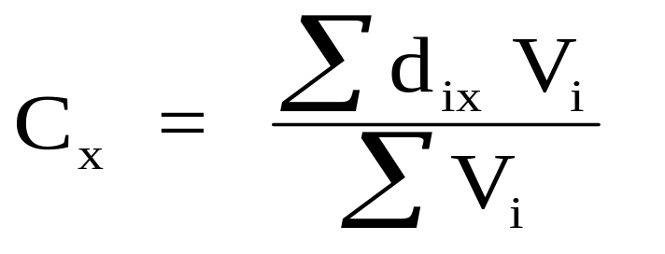
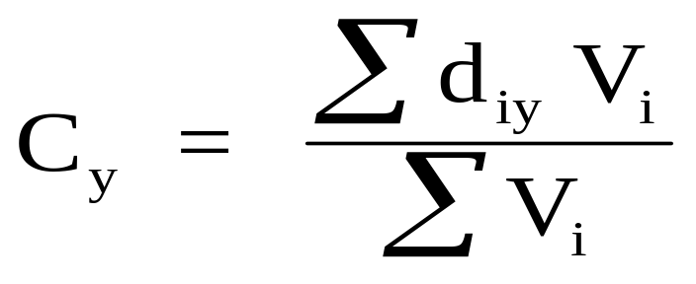
Plant Location Methodology: Centroid Method Formulas
Where:
C_{x} = X coordinate of centroid
C_{y} = X coordinate of centroid
d_{ix} = X coordinate of the ith location
d_{iy} = Y coordinate of the ith location
V_{i} = volume of goods moved to or from ith
location
Notes:
12

Slide 11
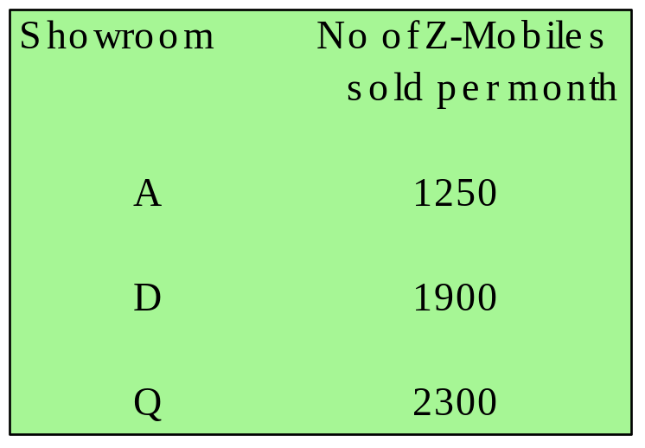
Plant Location Methodology: Example of Centroid Method
Centroid method example
  Several automobile showrooms are located according to the following grid which represents coordinate locations for each showroom
Y
Q
(790,900)
D
(250,580)
A
(100,200)
(0,0)
X
Question: What is the best location for a new Z-Mobile warehouse/temporary storage facility considering only distances and quantities sold per month?
Notes:
11

Slide 12

Plant Location Methodology: Example of Centroid Method (Continued): Determining Existing Facility Coordinates
To begin, you must identify the existing facilities on a two-dimensional plane or grid and determine their coordinates.
Y
Q
(790,900)
D
(250,580)
A
(100,200)
(0,0)
X
You must also have the volume information on the business activity at the existing facilities.
Notes:
12

Slide 13

Plant Location Methodology: Example of Centroid Method (Continued): Determining the Coordinates of the New Facility
You then compute the new coordinates using the formulas:
You then take the coordinates and place them on the map:
Y
Q
New location of facility Z about (443,627)
(790,900)
Z
D
(250,580)
A
(100,200)
(0,0)
X
Notes:
13

Slide 14
End of Technical Note 10

